Slide 1
How to use this Presentation
STOP
Use this internal slide deck to rally stakeholders and build internal excitement for the project.
Visit www.autobooks.co/Q2 to learn more
Questions? Email: FIGrowth@autobooks.co

Slide 2
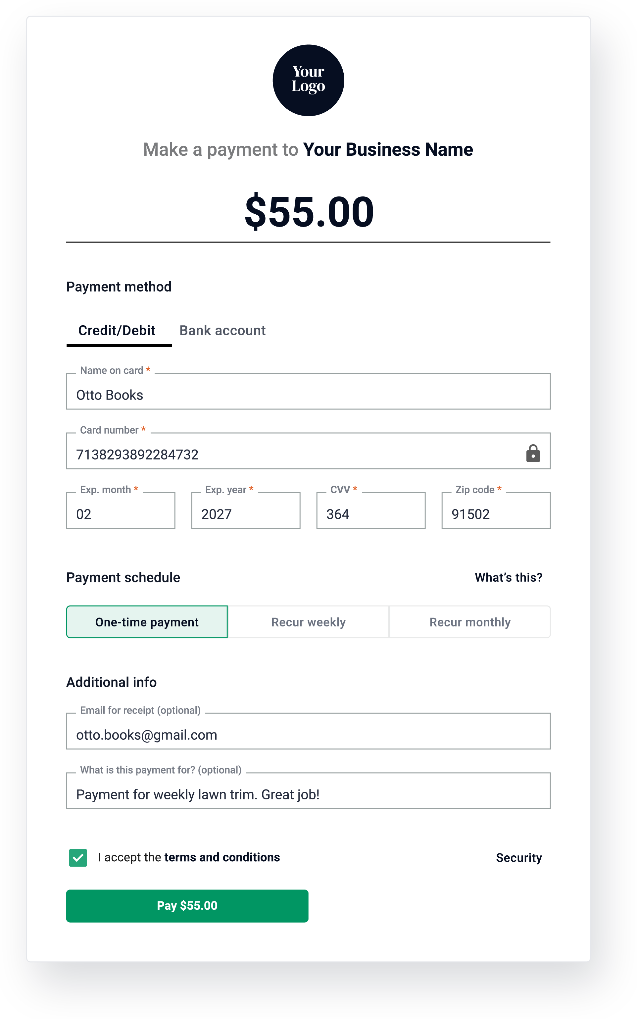
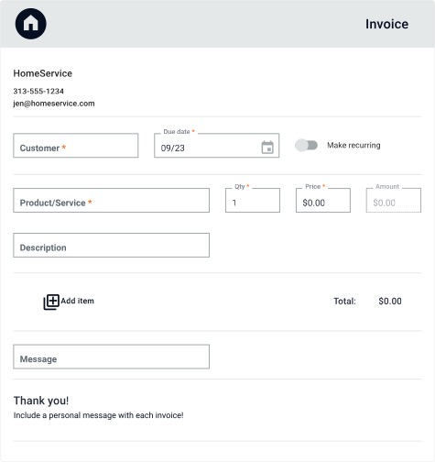

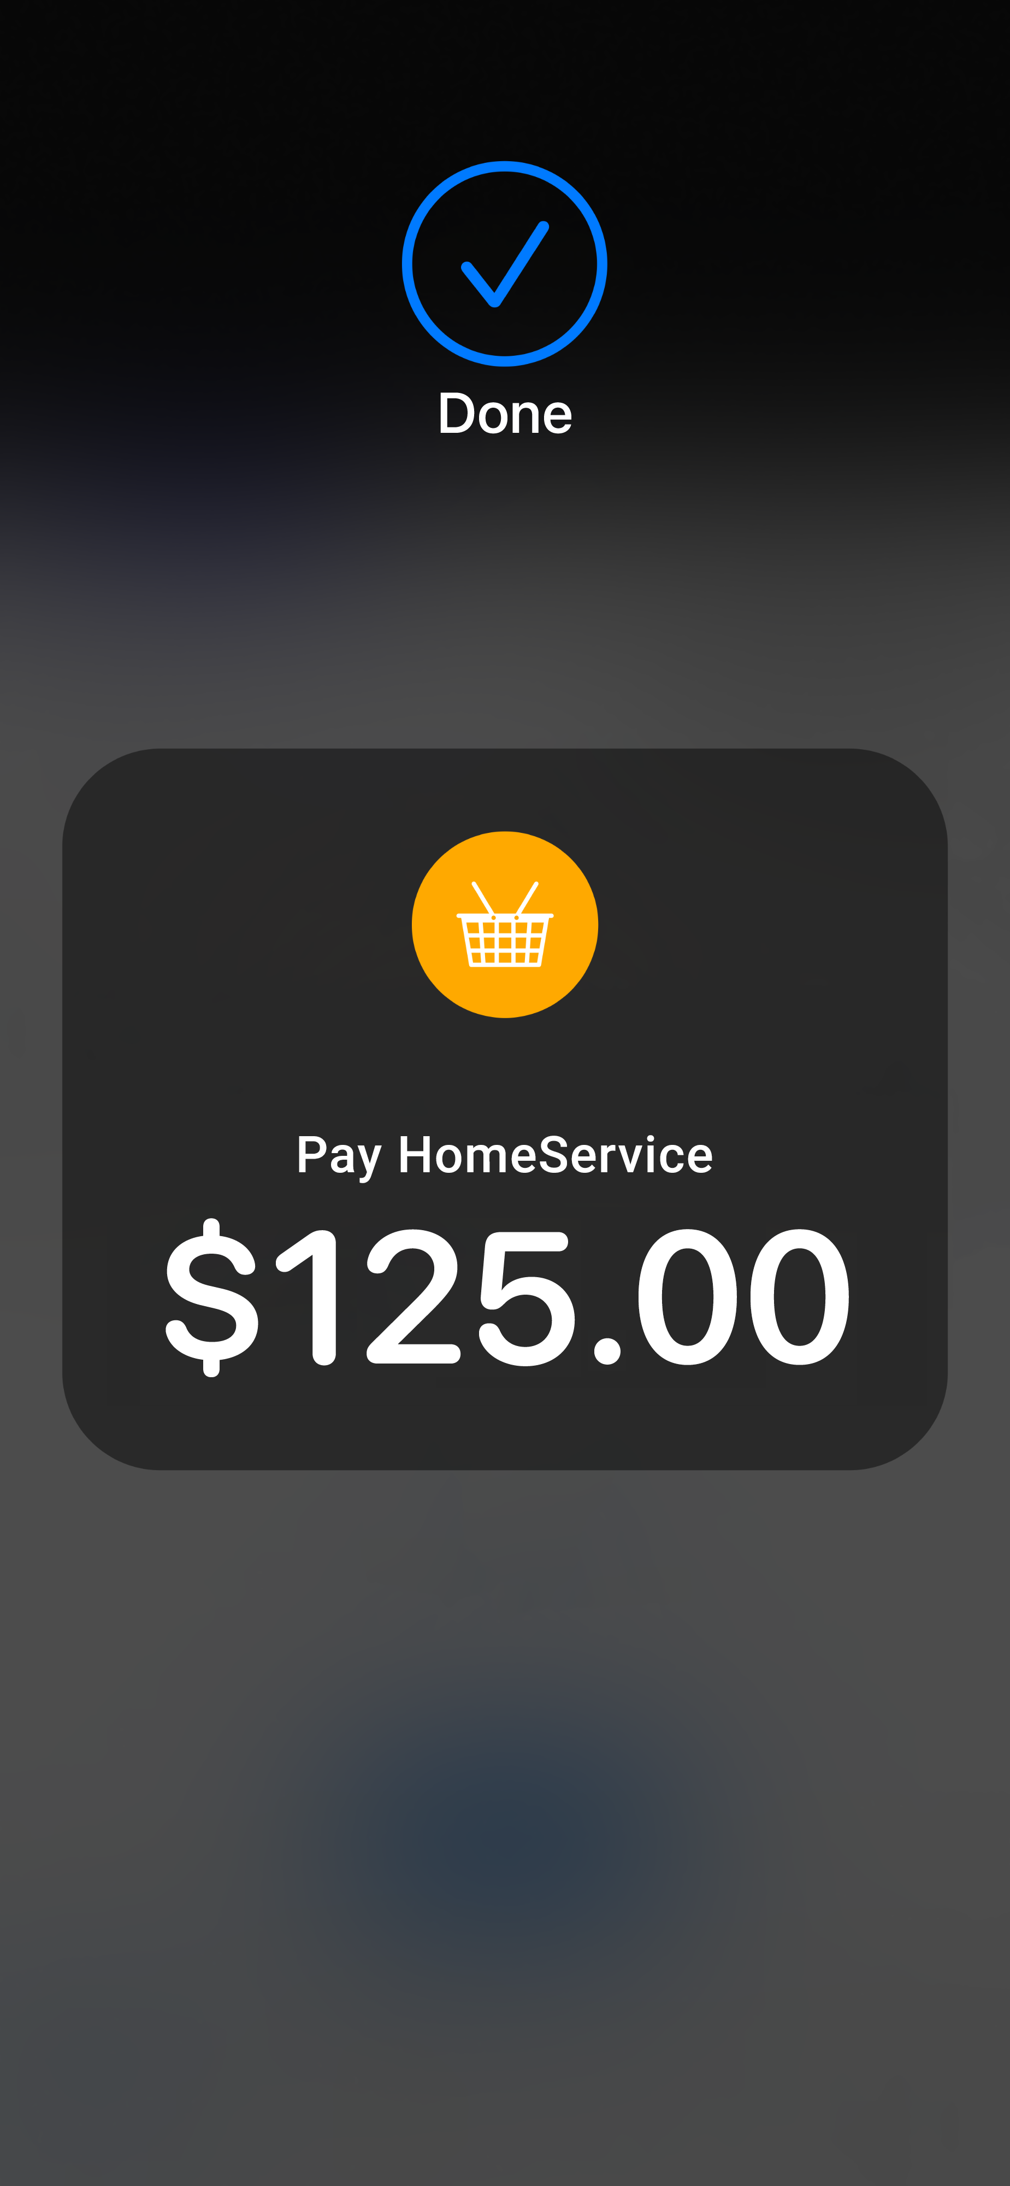
ONLINE INVOICING
PAYMENT LINK
TAP TO PAY ON IPHONE
Create and send professional invoices in the same place you do your banking.
Accept card payments or donations, anytime. Online, in-app, or over the phone.
Accept contactless payments with only an iPhone.
Learn more →
Learn more →
Learn more →

Slide 3
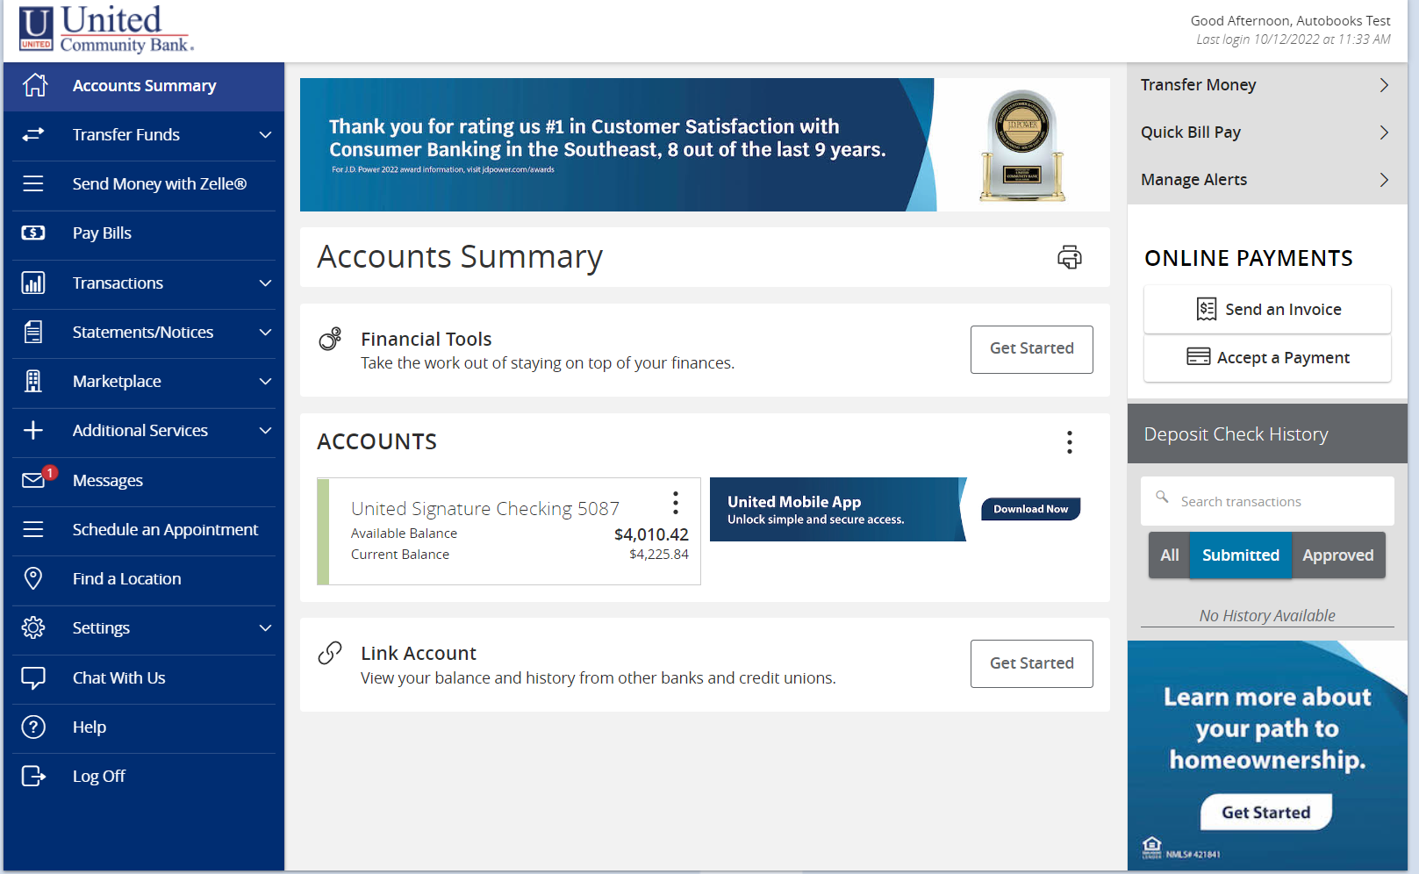
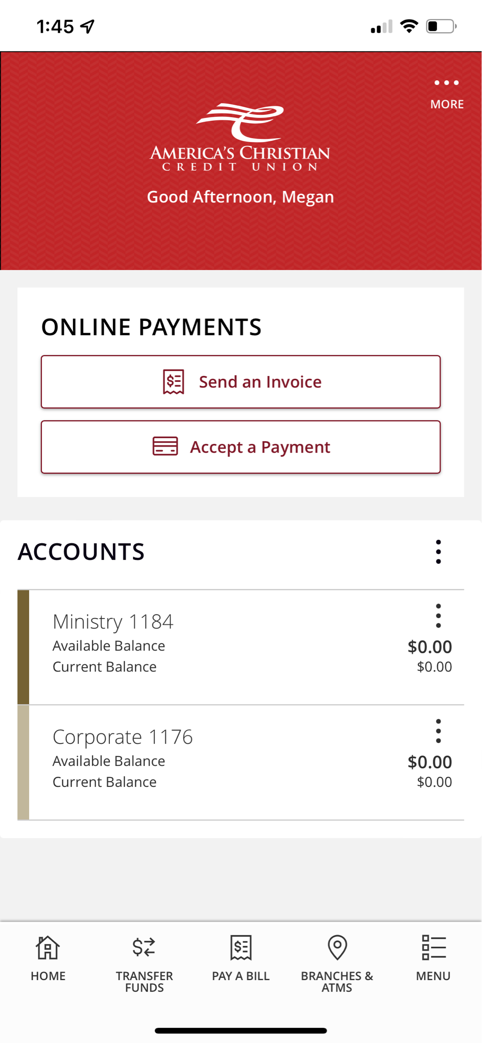
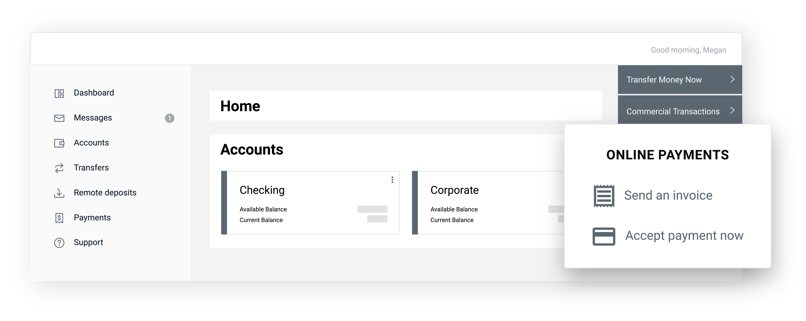
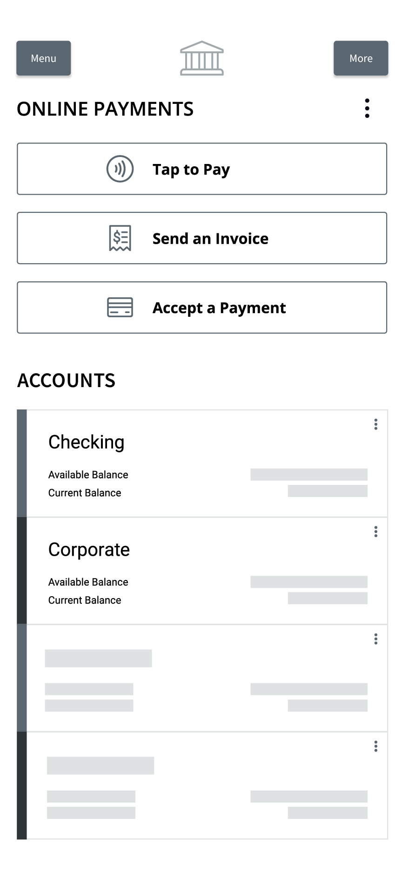
Enable businesses to get paid directly through your banking channels
Leverage available real estate for increased business functionality.
Now your Small Business can get paid digitally right on their home screen!
Seamlessly integrate the ability to receive a payment into the mobile experience for Small Businesses.

Slide 4
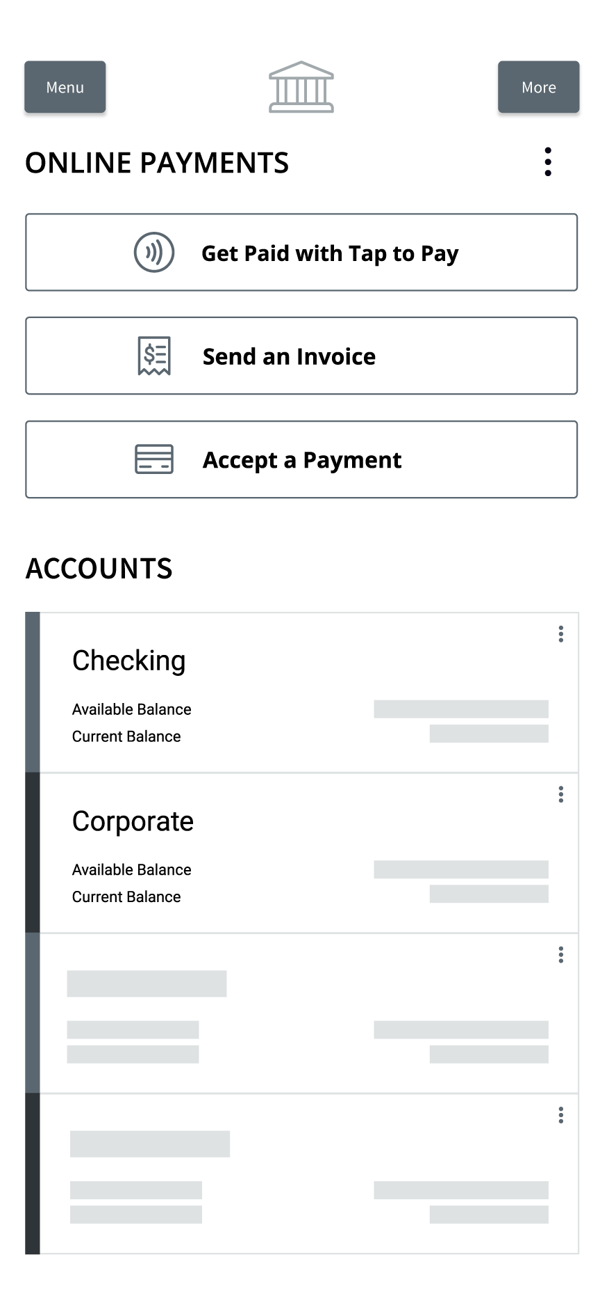

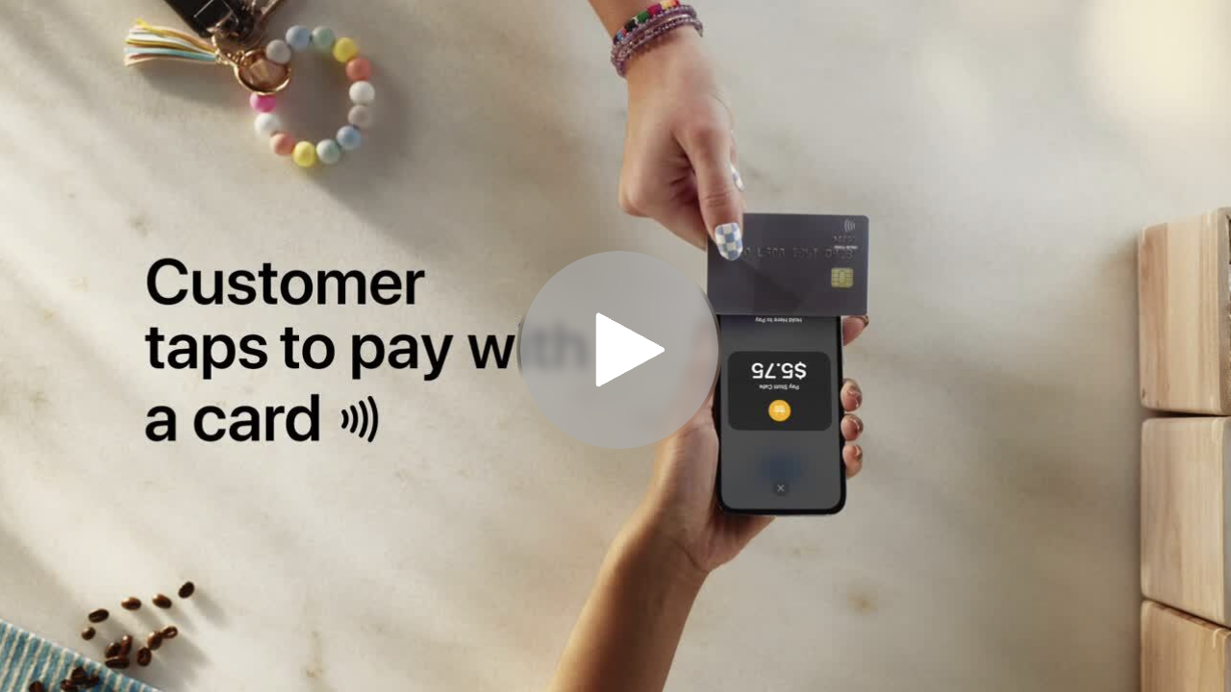
Tap to Pay on iPhone
NOW AVAILABLE!

Slide 5
How businesses and non-profits get paid is changing

Slide 6


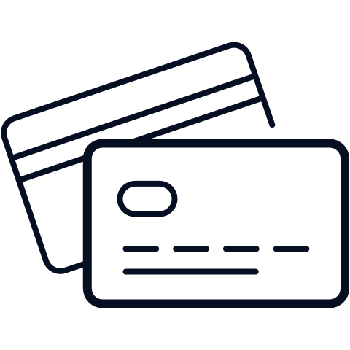
Small businesses are turning away from accepting cash and check in person, to accepting in-app and online payments via card
73%
of small businesses (SMBs) said new forms of digital payments
are fundamental to their growth
59%
plan to shift to using only digital payments within the next two years, or are already cashless
Notes:
Slide that demonstrates market shift to digital payment acceptance

Slide 7
Third-party app providers are targeting banks’ revenues
BANKS’
REVENUES
HOW SQUARE MAKES MONEY
NEARLY
80%
of small business revenue is at risk
Source: Celent analysis, Oliver Wyman revenue pools, and Square

Slide 8
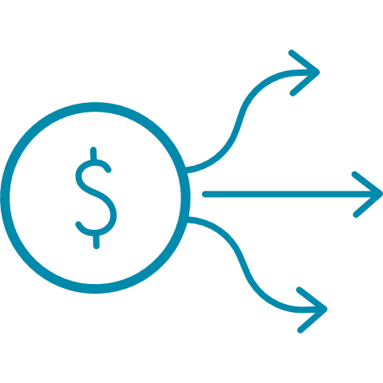


By helping small businesses get paid
(through existing digital banking channels) a financial institution can:
BETTER SERVICE AND SUPPORT A CUSTOMER IN NEED
DIVERSIFY REVENUE STREAMS
EXPAND
RELATIONSHIP DEPTH

Slide 9
Meet the
Digital Payment Needs of Businesses and Non-profits

Slide 10
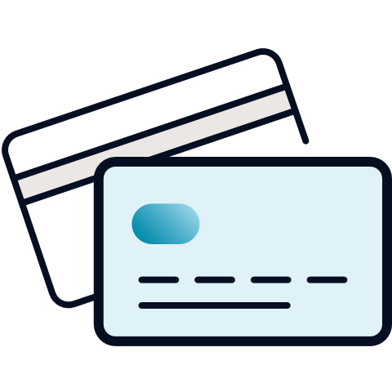


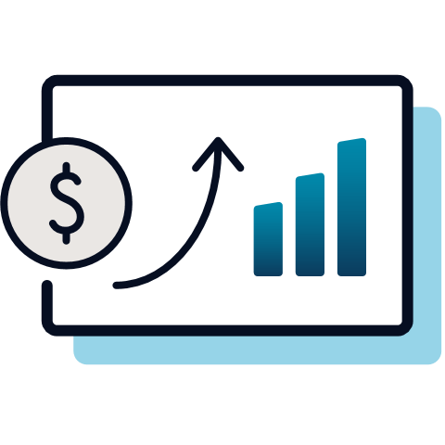
AUTOBOOKS FEATURES
Accept digital payments, including all cards. | Send professional invoices with the ability to customize them. | Get paid directly into their account, where they can access funds easily. | Manage cash flow, automate reporting and bookkeeping, and more
Learn more

Slide 11

Send a line-item digital invoice
to a customer
  Trades
  Professional services
  Storage facilities
  HOAs
  and more…

Slide 12

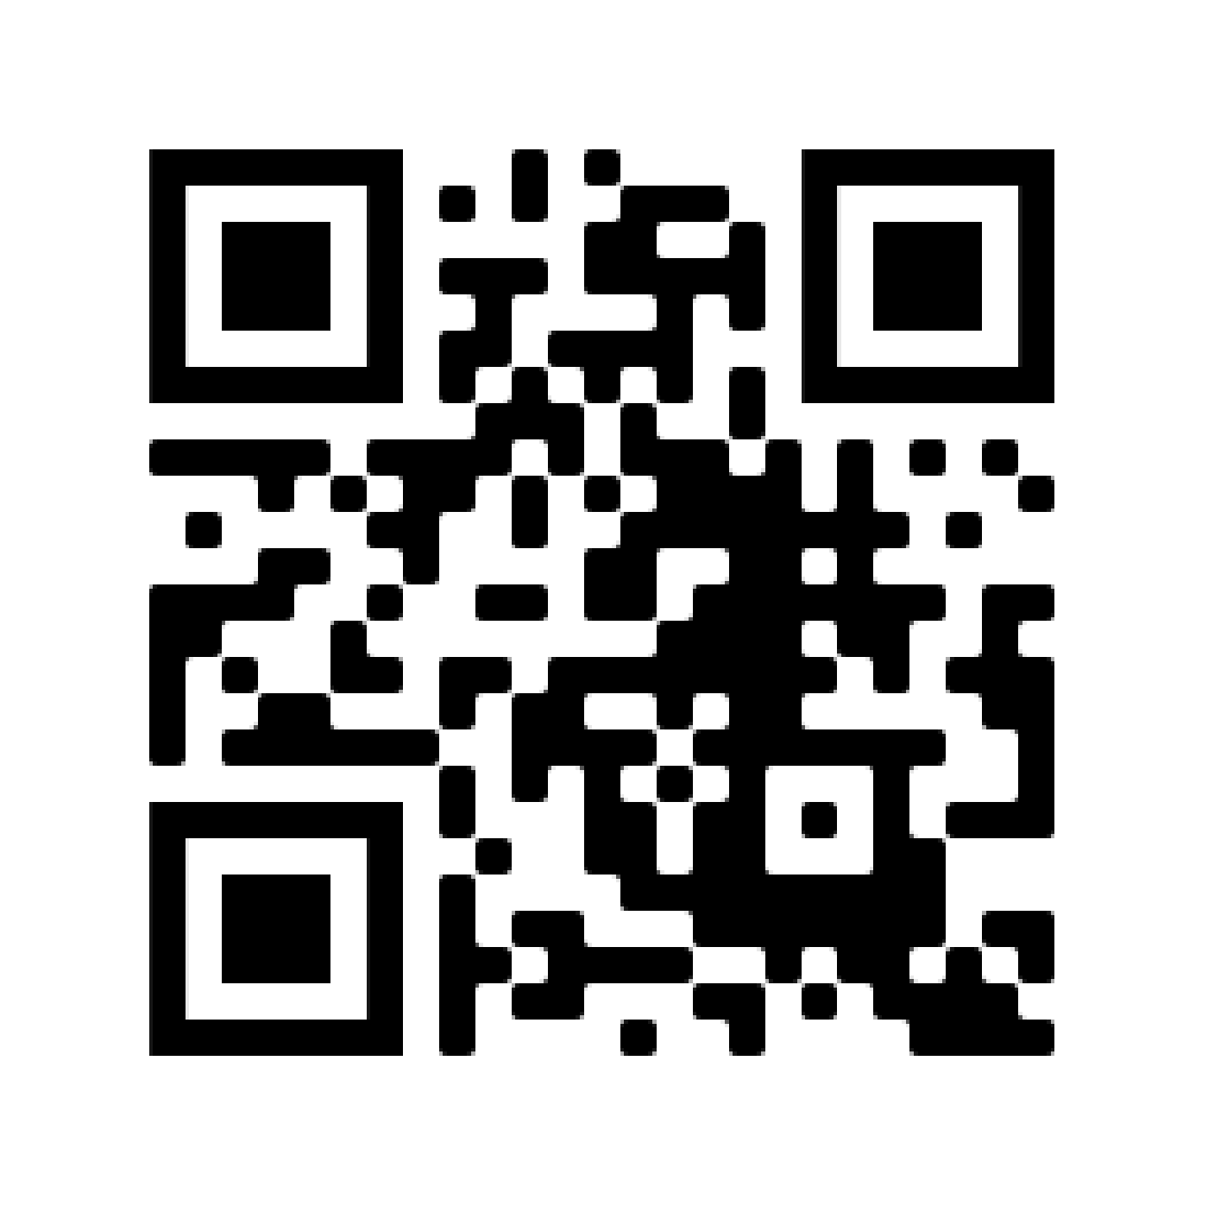
Get paid through
a QR code
  Retail
  Nonprofits
  Events
  and more…
Jenny’s Jewelry

Slide 13
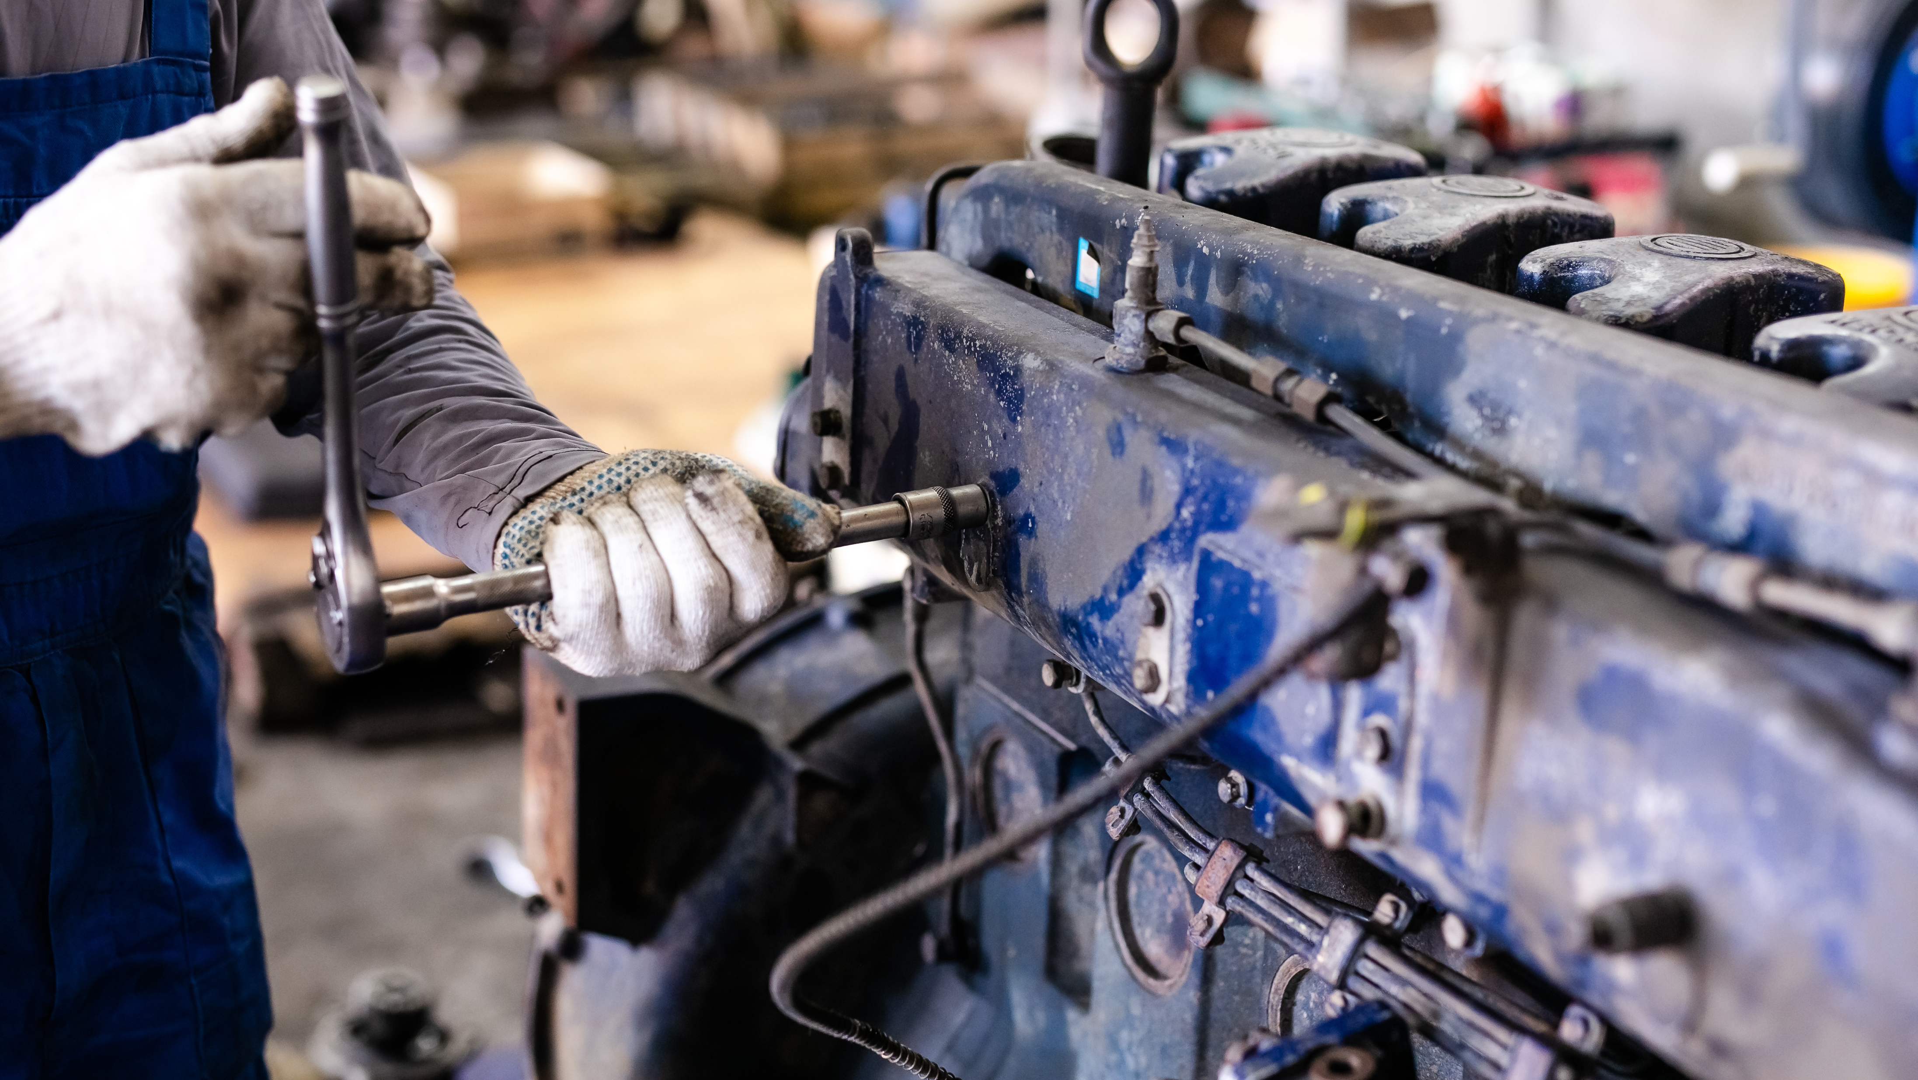
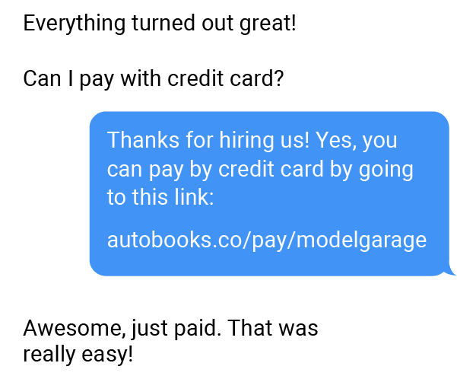
Text a secure payment link
  Trades
  Gig workers
  Personal services
  and more…

Slide 14

Get paid online through
secure payment link
Click here to pay now
  eCommerce
  Municipalities
  Nonprofits
  Churches
  and more…

Slide 15

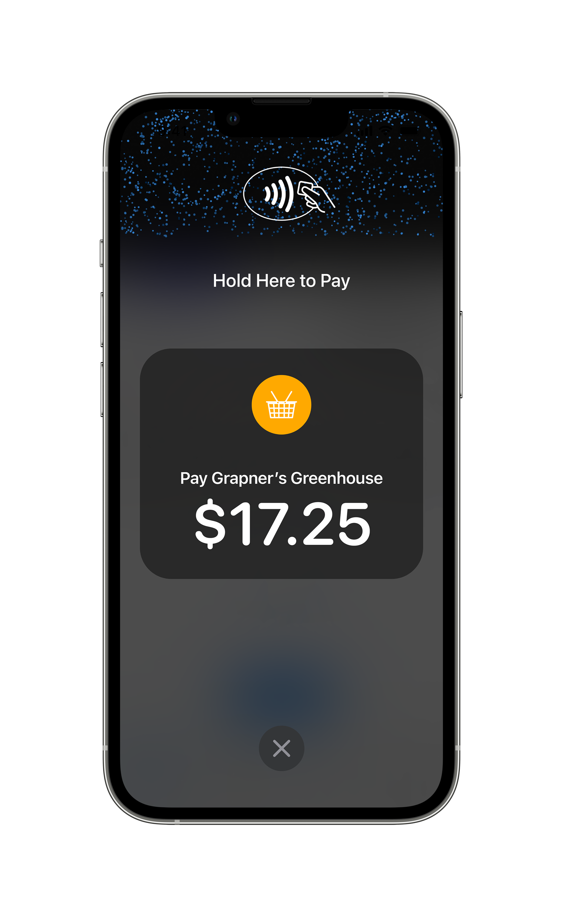
Get paid in-app through Tap to Pay
  Mobile retail
  Art and entertainment
  Trades and gig workers
  and more…

Slide 16
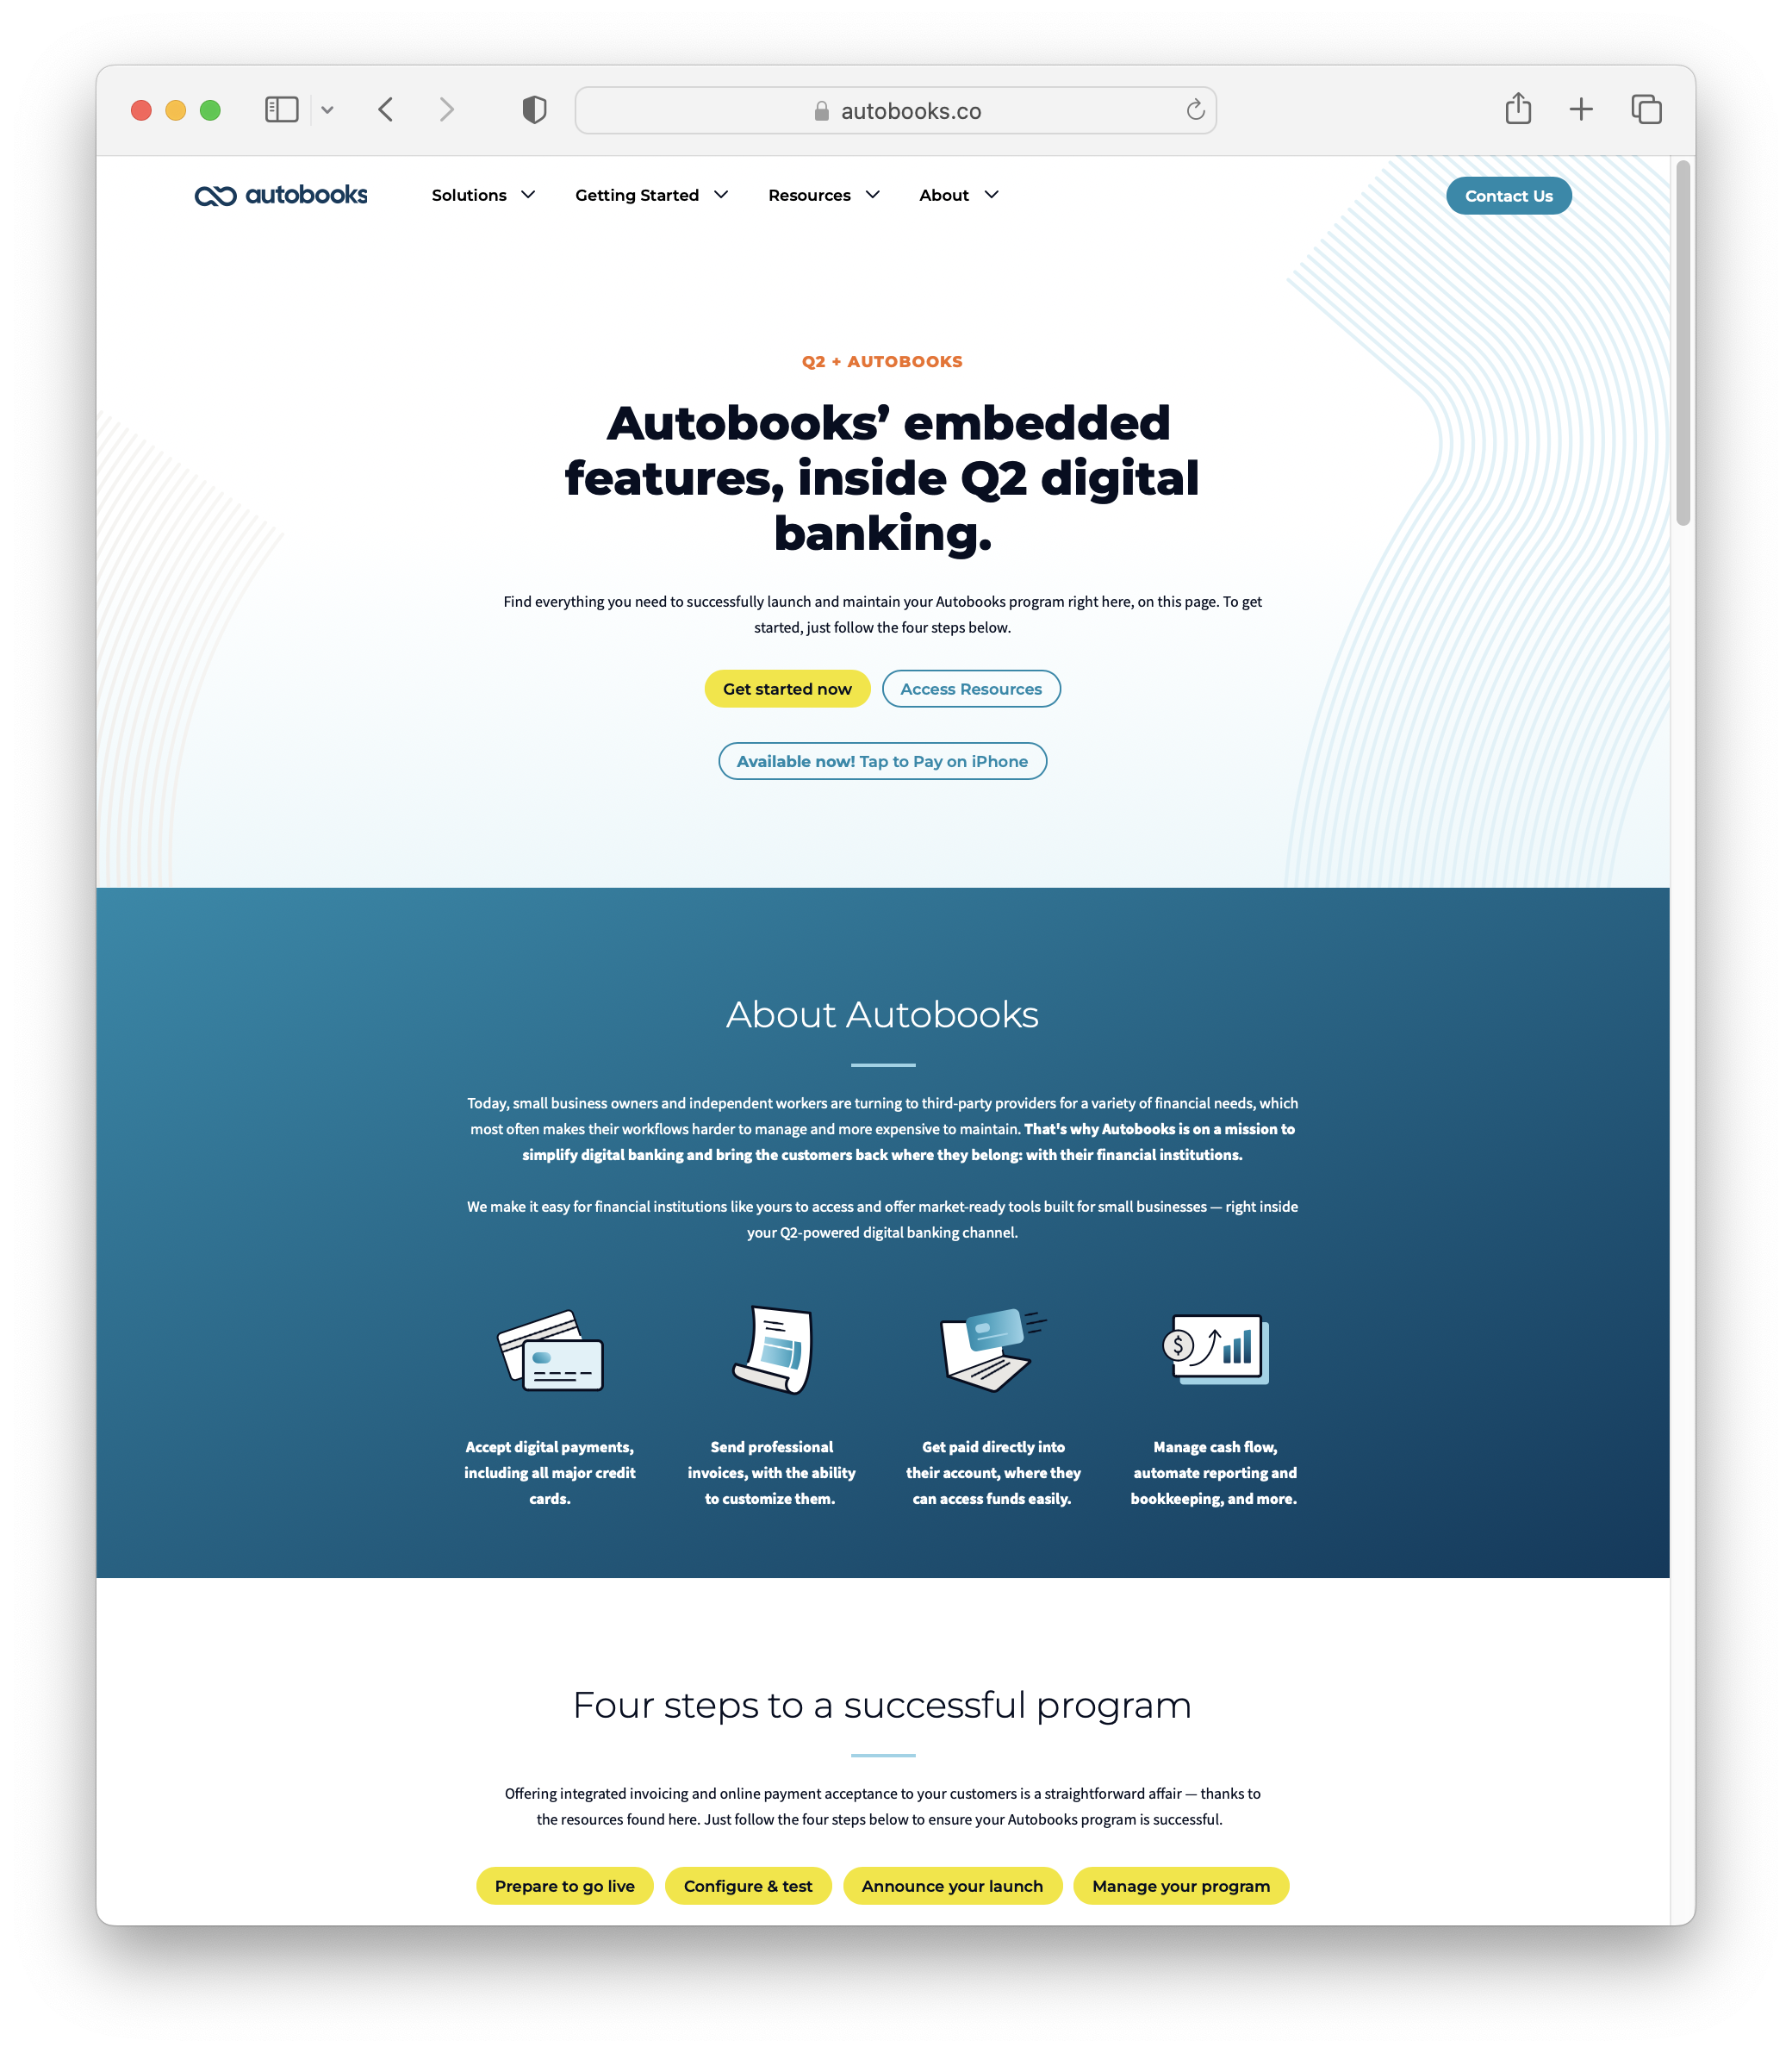
Visit autobooks.co/Q2 to learn more

Slide 17

Connect with Autobooks
autobooks.co/Q2
Let’s connect:
Email: FIGrowth@autobooks.co

Slide 18
How
Small Businesses
Get Paid

Slide 19
33.2
million
Small Businesses
According to the SBA (2022)
64.6
million
Independent
Workers
According to MBO Partners (2022)
81% have no paid employees
Redefining the needs of small business banking.
Proprietary & Confidential
Notes:
New research from MBO Partners shows 64.6 million Americans are now working independently; 26% year over year increase and 69% growth since 2020
- https://www.mbopartners.com/state-of-independence/
- https://advocacy.sba.gov/wp-content/uploads/2023/03/Frequently-Asked-Questions-About-Small-Business-March-2023-508c.pdf
Commentary:
https://www.yahoo.com/now/going-going-gone-study-reveals-140000229.html?guccounter=1&guce_referrer=aHR0cHM6Ly93d3cuZ29vZ2xlLmNvbS8&guce_referrer_sig=AQAAAL70YWtrTYv-ZyBOW97zgikMdZ-a2EbKZgGMZsYa_FdD5B5pF4u16imI3fxh99nLthqAk0UBJUmwGmeiLcEL71RTSGaaH0kbdDTpxyrcO-RCBd6MH10vydr9wGn3UCB-bdaau6v7-RGhyunChFhkDmkEq-RzPhxRqArg880xdcOc

Slide 20
Small businesses are turning away from accepting cash and check in person, to accepting in-app and online payments via card
73%
of small businesses (SMBs) said new forms of digital payments
are fundamental to their growth
59%
plan to shift to using only digital payments within the next two years, or are already cashless
Notes:
Slide that demonstrates market shift to digital payment acceptance

Slide 21
Third-party app providers are targeting banks’ revenues
BANKS’
REVENUES
HOW SQUARE MAKES MONEY
NEARLY
80%
of small business revenue is at risk
Source: Celent analysis, Oliver Wyman revenue pools, and Square

Slide 22



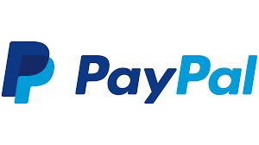
Better compete against non-bank providers
AUTOBOOKS HELPS RECLAIM DEPOSITS & FEE INCOME
$3.5M
Monthly Deposits
Cumulative
Total Deposits
Autobooks usage
grew monthly deposits from ~$80,000 a month, to over $500,000 a month.
Representing a
525% increase in organic deposit growth
*Bank achieved 3% adoption (308 SMB enrollments) in first ~9 months.
*Cohort (above) represents ~10% of SMBs (31) that utilized Non-Bank Providers + Autobooks for 12 consecutive months.

Slide 23

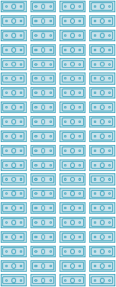
What does that mean?
For every $1 deposited into the FI from a third-party app …
$7 stayed
in the app
$80,000 a month deposited
$580,000 a month deposited

Slide 24
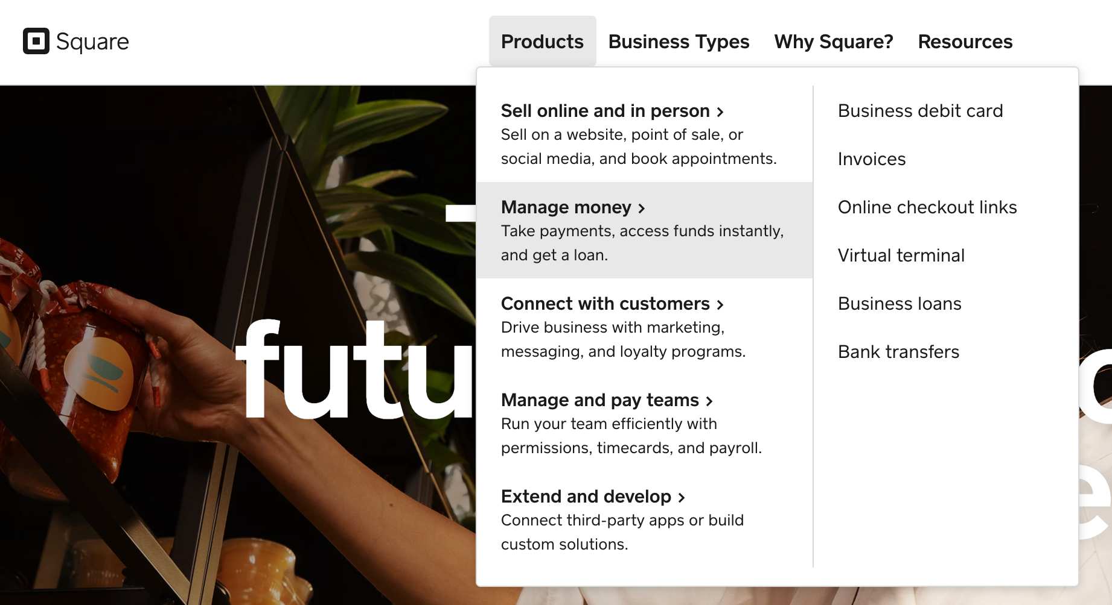
Competitors position their solutions around the value prop of helping a business get paid

Slide 25
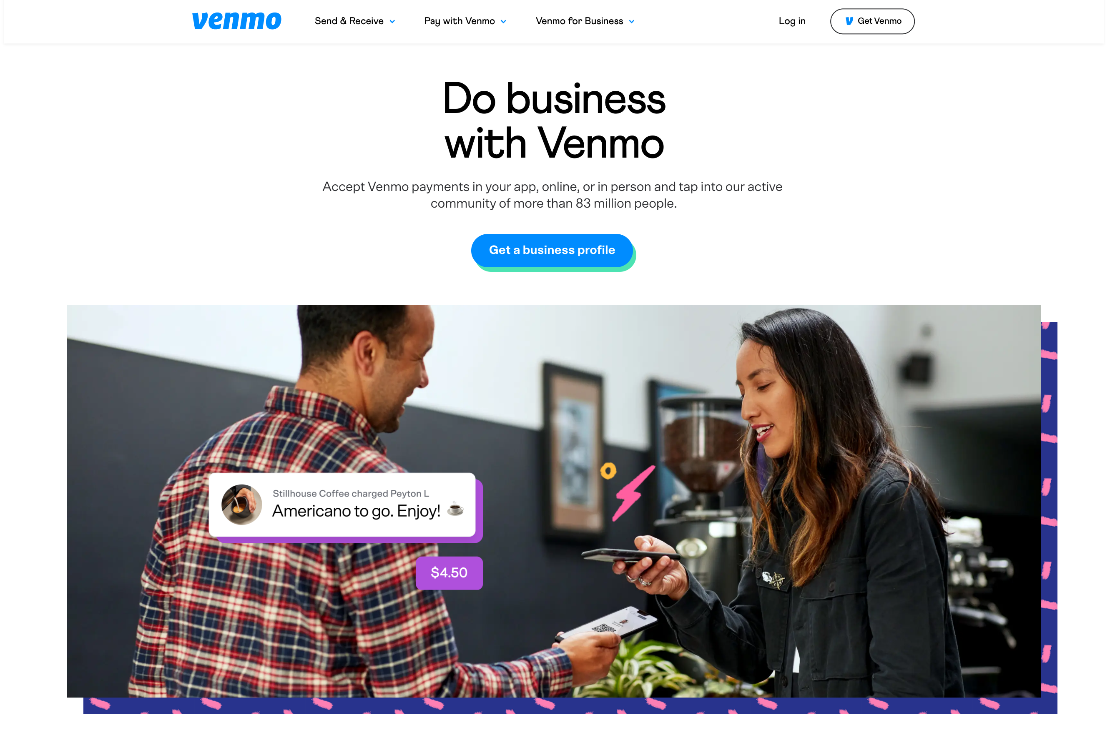

Slide 26
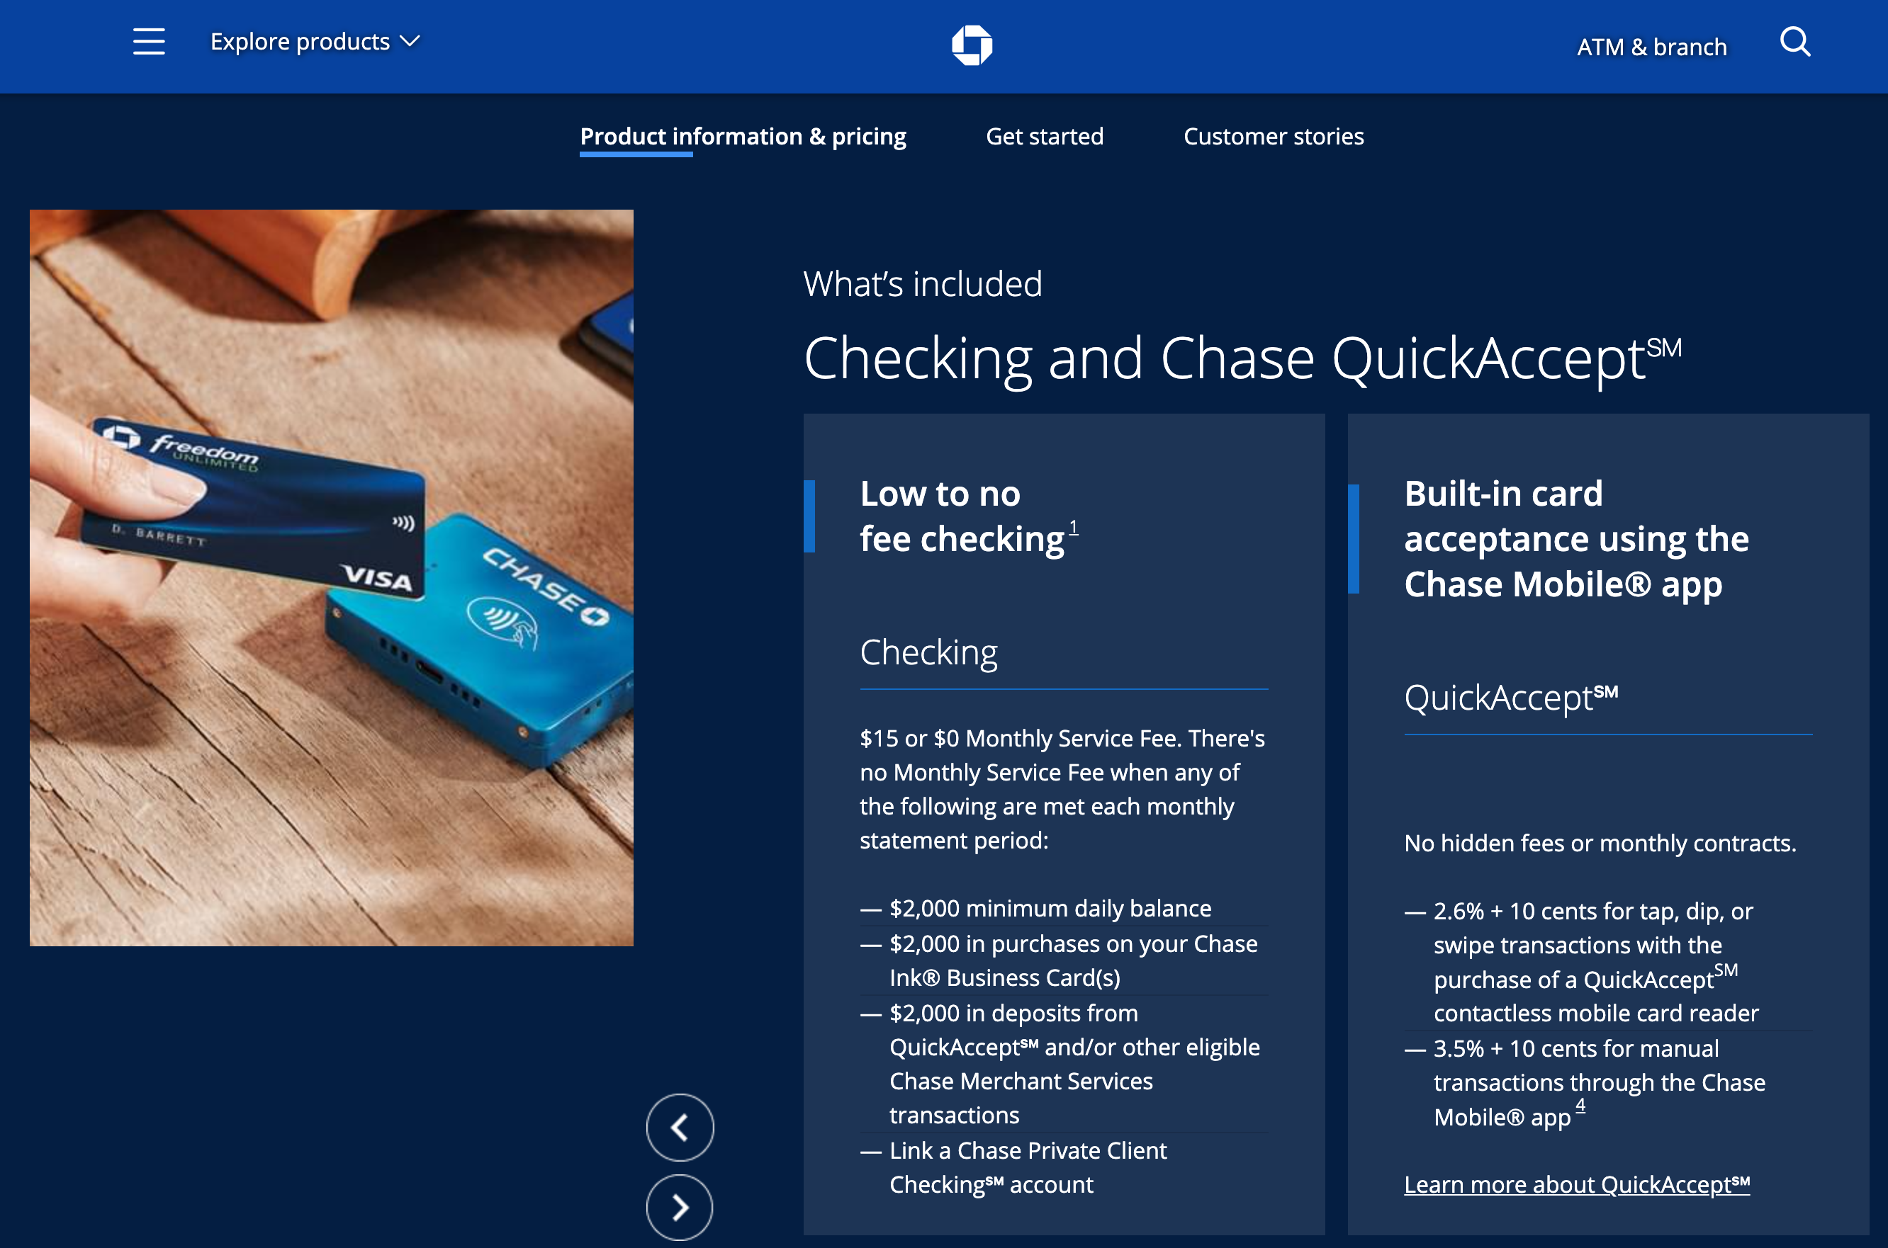

Slide 27


When a small business visits your bank, what do you offer for digital payment acceptance?
Consumer banking
is too basic & lacks payment acceptance tools
Commercial banking
is too complex & the payment
acceptance tools are not the right fit
Your Bank
Treasury
Cash Services
Consumer
Banking
Commercial
Banking
Check My Balance
Entitlements
Positive Pay
ACH
Transfer Money
Merchant Services
Business Bill Pay
Pay Bills
Remote Deposit Capture
Lockbox

Slide 28


WHAT SMALL BUSINESSES ARE SAYING…
We've been looking for a tool that will allow us to more conveniently accept and manage credit card payments. It's just been very difficult. We've had a relationship with Bank of America for years, but they don't really have an easy mechanism outside of like a Square-type terminal to address that need, but some of their fees are really exorbitant.
GENERAL CONTRACTOR
Now I'm able to utilize Tap to Pay on iPhone without having to have Square connected on multiple devices. I do graphic design, so it’s great to be able to take a payment right there on the spot — whether it’s at a marketing show, flea market, a pop up, or just at the office.
GRAPHIC DESIGNER

Slide 29
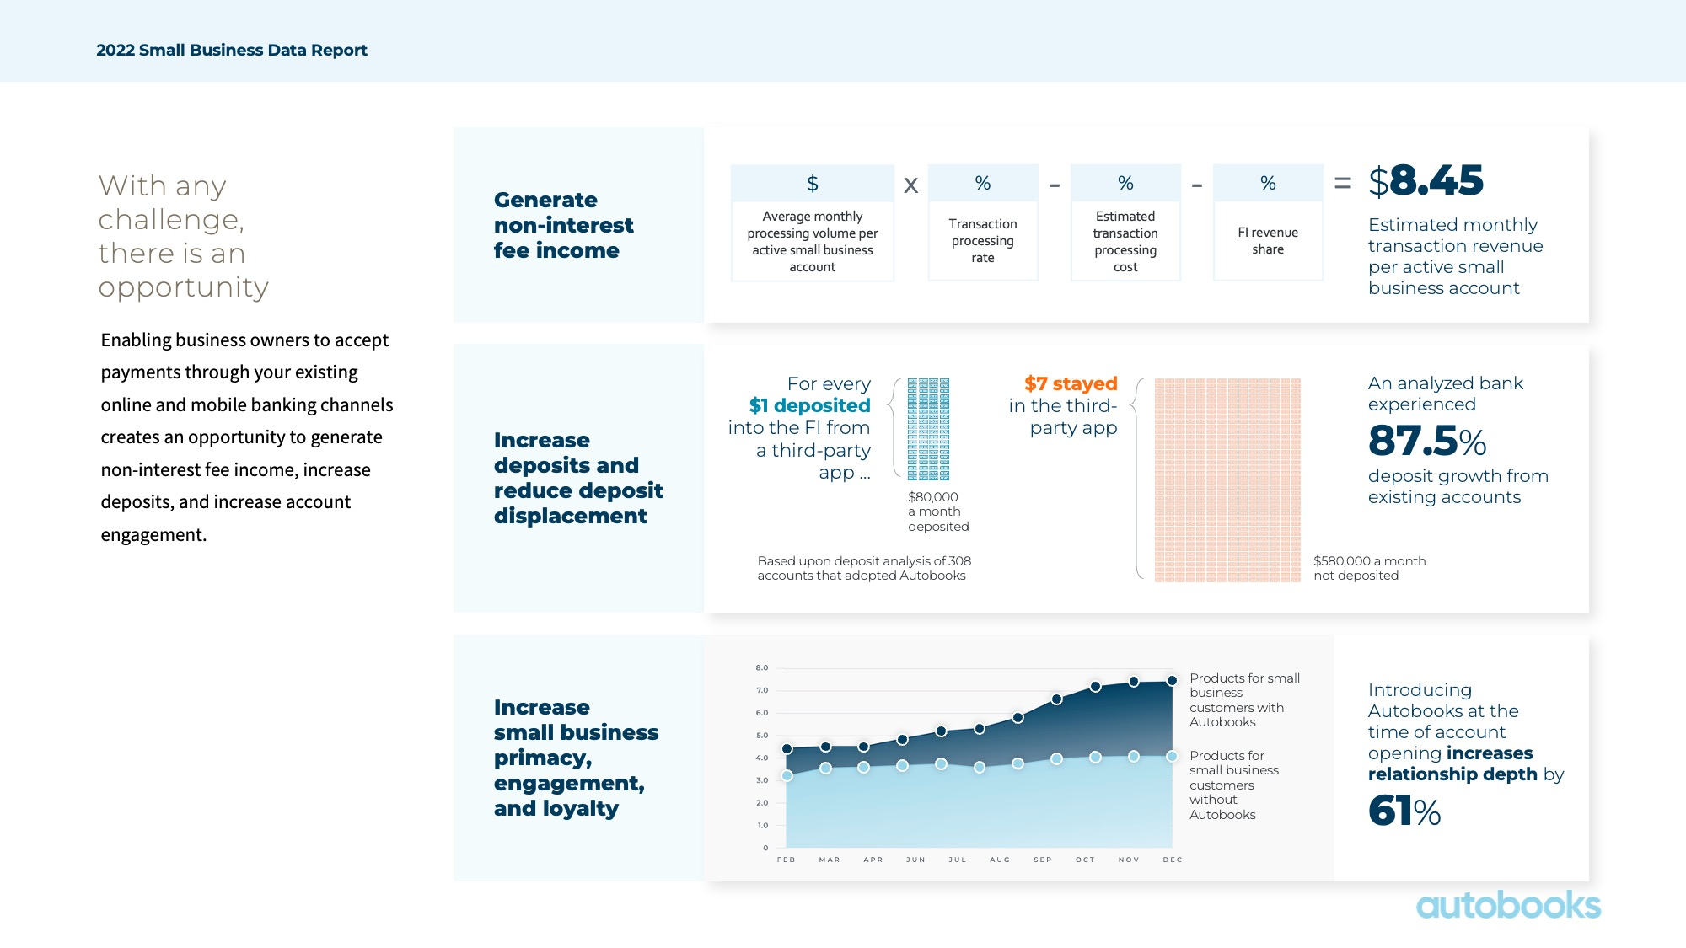
Download the report →

Slide 30
What outcomes are banks realizing?
INCREASED
Deposit Balance
INCREASED
Engagement & Product Depth
+65%
PRODUCT | AB | SMB Avg | % Change
Online Banking | 99.3% | 82.6% | 20%
Mobile | 22.6% | 12.3% | 82%
Debit Card | 89.0% | 57.5% | 55%
Merchant Services | 5.2% | 2.4% | 117%
ACH Credit | 8.2% | 1.1% | 645%
Bill Pay | 90.0% | 30.2% | 198%
Payroll | 2.8% | .4% | 600%
Branch Deposit | 29.9 | 32.5% | -8%
eStatements | 77.1% | 56.4% | 37%
Relationship Depth | 6.4 (existing SMB) 8.2 (new to bank) | 3.9 | 64% 110%
Merchant Services | 5.2% | 2.4% | 117%
Relationship Depth | 6.4% (existing SMB) 8.2% (new to bank) | 3.9% | 64% 110%

Slide 31
Deploying Autobooks is your Anti-Project
Get a Quick Win
Cost of Project
Don’t Derail Other Projects
  Deliver value to
  your businesses and non-profits fast.
  From kick off to go live, projects average less than 4 weeks in length.
  No cost – this feature is included with your Q2 install!
  Autobooks and Q2
  handle the technical install, requiring 1 hour per week of time from the financial institution.

Slide 32



Accepting a Payment →
Autobooks Product Videos
Invoicing →
Mobile Invoicing →

